Slide 1
Inheritance and Polymorphism

Slide 2
Main Concepts of OOP
Encapsulation
  abstraction, Information hiding
Inheritance
  code reuse, specialization "New code using old code."
Polymorphism
  do X for a collection of various types of objects, where X is different depending on the type of object
  "Old code using new code."

Slide 3
Encapsulation
Encapsulation is a fundamental concept in object-oriented programming (OOP) that refers to the bundling of data and methods that operate on that data within a single unit, which is called a class in Java.
Java Encapsulation is a way of hiding the implementation details of a class from outside access and only exposing a public interface that can be used to interact with the class.
In Java, encapsulation is achieved by declaring the instance variables of a class as private, which means they can only be accessed within the class.

Slide 4
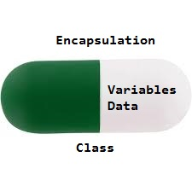
Encapsulation
to allow outside access to the instance variables, public methods called getters and setters are defined, which are used to retrieve and modify the values of the instance variables, respectively .
By using getters and setters, the class can enforce its own data validation rules and ensure that its internal state remains consistent.

Slide 5
Advantages of Encapsulation
Data Hiding
Increased Flexibility
Reusability
Easy Code T esting
Freedom to programmer in implementing the details of the system:

Slide 6
Inheritance
Inheritance allows a software developer to derive a new class from an existing one
The class that is inherited is called the parent class, or superclass, or base class
The derived class or the class that does the inheriting is called the child class or subclass.
As the name implies, the child inherits characteristics of the parent
That is, the child class inherits the methods and data defined for the parent class

Slide 7
Inheritance
By using a derived class, the programmer can add new variables or methods, or can modify the inherited ones
Software reuse is at the heart of inheritance
By using existing software components to create new ones, we capitalize on all the effort that went into the design, implementation, and testing of the existing software

Slide 8
Inheritance
Inheritance relationships often are shown graphically in a UML class diagram, with an arrow with an open arrowhead pointing to the parent class
Vehicle
Car
Inheritance should create an is-a relationship, meaning the child is a more specific version of the parent

Slide 9
Deriving Subclasses
In Java, we use the reserved word extends to establish an inheritance relationship
class Vehicle
{
// class contents
}
class Car extends Vehicle
{
// class contents
}

Slide 10
Member Access and Inheritance
Although a subclass includes all of the members of its superclass, it cannot access those members of the superclass that have been declared as private.

Slide 11
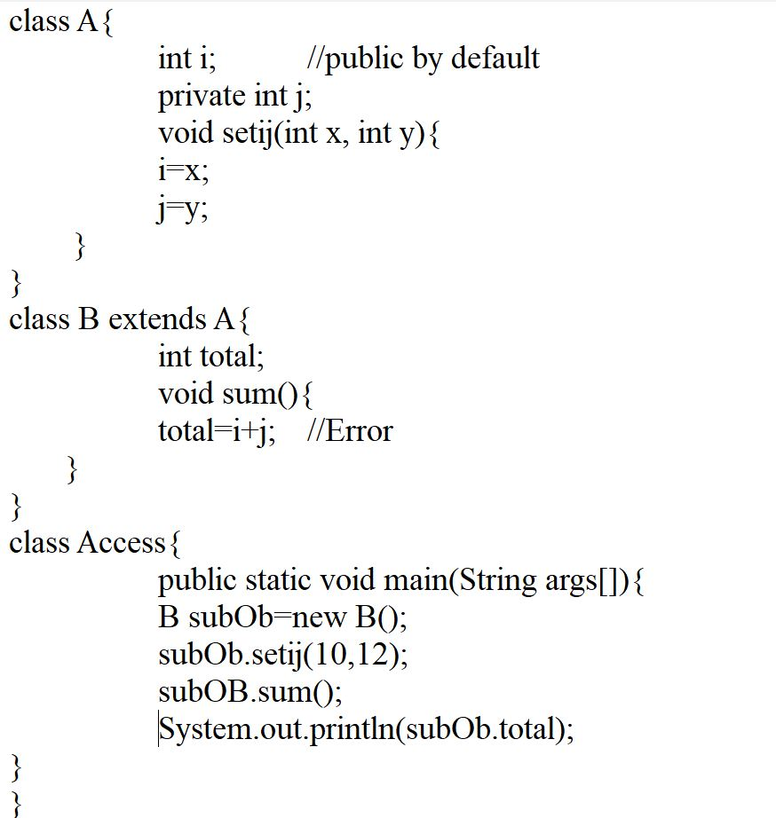
Member Access and Inheritance

Slide 12
The protected Modifier
Visibility modifiers determine which class members are inherited and which are not
Variables and methods declared with public visibility are inherited; those with private visibility are not
But public variables violate the principle of encapsulation
There is a third visibility modifier that helps in inheritance situations: protected

Slide 13
The protected Modifier
The protected modifier allows a member of a base class to be inherited into a child
Protected visibility provides more encapsulation than public visibility does
However, protected visibility is not as tightly encapsulated as private visibility
Protected variables and methods can be shown with a # symbol preceding them in UML diagrams

Slide 14
UML Diagram for Words
Book
# pages : int
+ pageMessage() : void
Words
Dictionary
- definitions : int
+ main (args : String[]) : void
+ definitionMessage() : void

Slide 15
A Superclass Variable can Reference a Subclass Object
A reference variable of a superclass can be assigned a reference to any subclass derived from that superclass.
This aspect of inheritance is quite useful in a variety of situations.

Slide 16
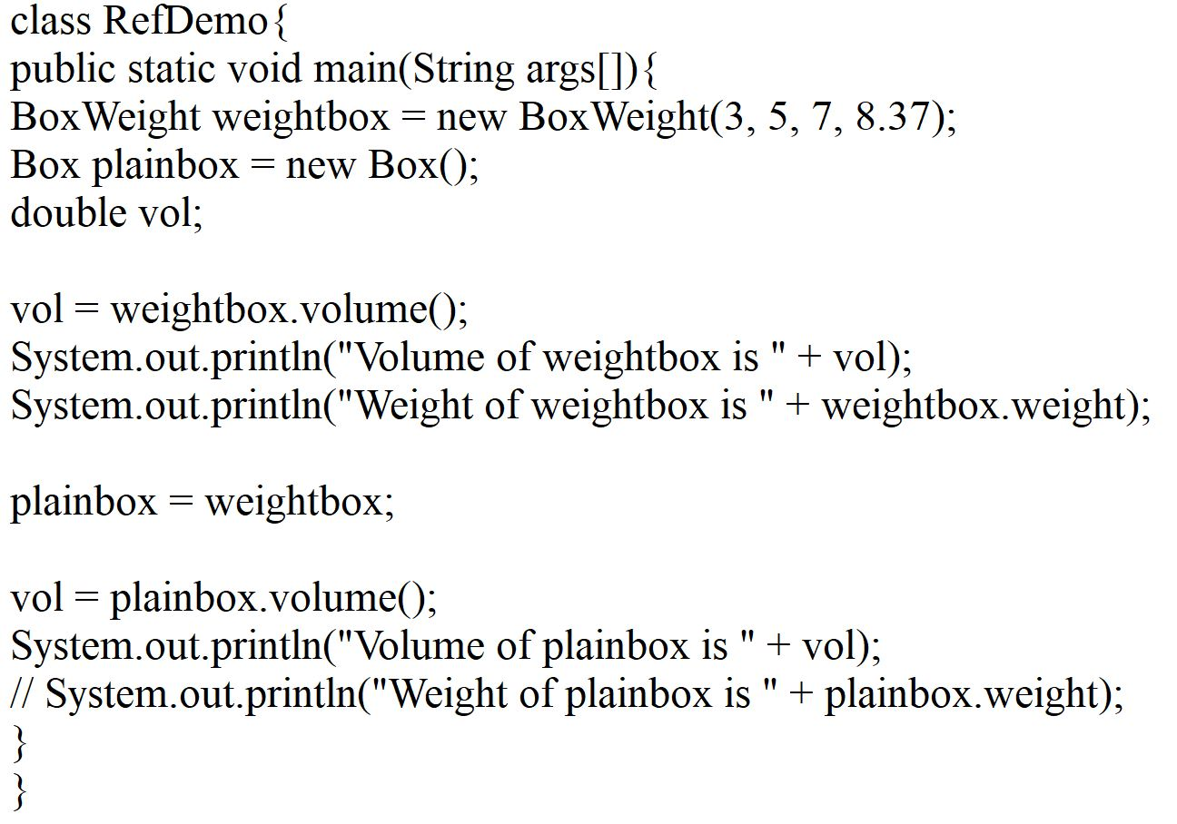
A Superclass Variable can Reference a Subclass Object

Slide 17
The super Reference
Constructors are not inherited, even though they have public visibility
Yet we often want to use the parent's constructor to set up the "parent's part" of the object
The super reference can be used to refer to the parent class, and often is used to invoke the parent's constructor

Slide 18
The super Reference
super has two general forms.
The first calls the superclass’ constructor.
The second is used to access a member of the superclass that has been hidden by a member of a subclass.

Slide 19
The super Reference
class BoxWeight extends Box
{
double weight;
BoxWeight(double w, double h, double d, double m)
{
super(w, h, d);
weight = m;
}
}

Slide 20
The super Reference
A child’s constructor is responsible for calling the parent’s constructor
The first line of a child’s constructor should use the super reference to call the parent’s constructor
The super reference can also be used to reference other variables and methods defined in the parent’s class

Slide 21
The Second Use of super
The second form of super acts somewhat like this, except that it always refers to the superclass of the subclass in which it is used.
This second form of super is most applicable to situations in which member names of a subclass hide members by the same name in the superclass.

Slide 22
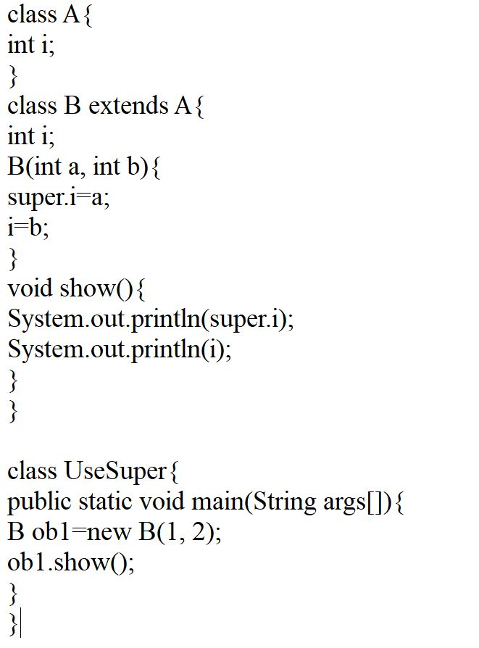
The Second Use of super

Slide 23
Multiple Inheritance
Java supports single inheritance, meaning that a derived class can have only one parent class
Multiple inheritance allows a class to be derived from two or more classes, inheriting the members of all parents
Collisions, such as the same variable name in two parents, have to be resolved
Java does not support multiple inheritance
In most cases, the use of interfaces gives us aspects of multiple inheritance without the overhead

Slide 24
When Constructors Are Called
When a class hierarchy is created, in what order are the constructors for the classes that make up the hierarchy called?
For example, given a subclass called B and a superclass called A, is A ’ s constructor called before B’s or vice-versa?
Constructors are called in order of their derivation, from superclass to subclass.
Since, super() must be the first statement executed in a subclass’ constructor , this order is the same whether or not super() is used.
If super() is not used, then the default or parameterless constructor of each superclass will be executed.

Slide 25
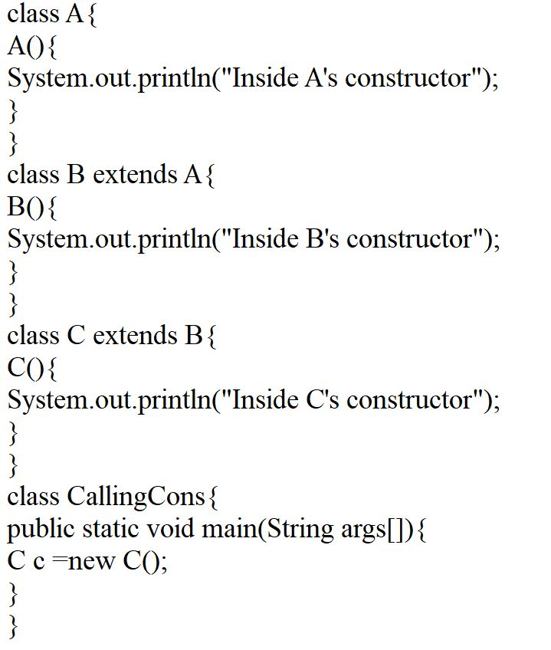
When Constructors Are Called

Slide 26
Contd…..
Constructors are executed in order of derivation. Because a superclass has no knowledge of any subclass, any initialization it needs to perform is separate from and possibly prerequisite to any initialization performed by the subclass. Therefore, it must be executed first.

Slide 27
Overriding Methods
A child class can override the definition of an inherited method in favor of its own
The new method must have the same signature as the parent's method, but can have a different body
The type of the object executing the method determines which version of the method is invoked

Slide 28
Overriding
A parent method can be invoked explicitly using the super reference
If a method is declared with the final modifier , it cannot be overridden
The concept of overriding can be applied to data and is called shadowing variables
Shadowing variables should be avoided because it tends to cause unnecessarily confusing code

Slide 29
Overloading vs. Overriding
Don't confuse the concepts of overloading and overriding
Overloading deals with multiple methods with the same name in the same class, but with different signatures
Overriding deals with two methods, one in a parent class and one in a child class, that have the same signature
Overloading lets you define a similar operation in different ways for different data
Overriding lets you define a similar operation in different ways for different object types

Slide 30
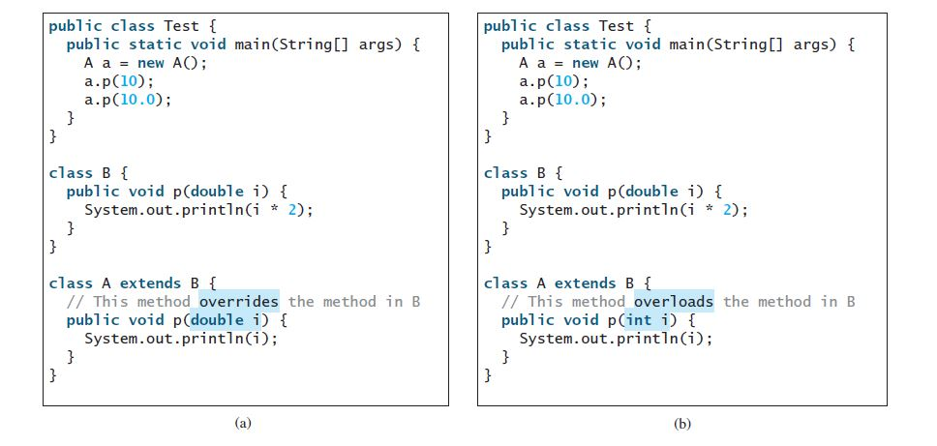
Overloading vs. Overriding

Slide 31
Dynamic Method Dispatch
Method Overriding forms the basis for one of Java’s most powerful concepts: Dynamic Method Dispatch
It is the mechanism by which a call to an overridden method is resolved at run-time, rather than compile-time.
It is the way of implementing run-time polymorphism.
When different types of objects are referred to, different versions of an overridden method will be called.
In other words, it is the type of the object being referred to (not the type of the reference variable) that determines which version of an overridden method will be executed.

Slide 32
Dynamic Method Dispatch
Therefore, if a superclass contains a method that is overridden by a subclass, then when different types of objects are referred to through a superclass reference variable, different versions of the method are executed.

Slide 33
Class Hierarchies
A child class of one parent can be the parent of another child, forming a class hierarchy
Business
RetailBusiness
ServiceBusiness
KMart
Macys
Kinkos

Slide 34
Class Hierarchies
2 children of the same parent are called siblings
Common features should be put as high in the hierarchy as is reasonable
An inherited member is passed continually down the line
Therefore, a child class inherits from all its ancestor classes
There is no single class hierarchy that is appropriate for all situations

Slide 35
Using final with Inheritance
The keyword final has 3 uses.
First, it can be used to create the equivalent of a named constant.
to prevent Overriding
to prevent Inheritance

Slide 36
The Object Class
A class called Object is defined in the java.lang package of the Java standard class library
All classes are derived from the Object class
If a class is not explicitly defined to be the child of an existing class, it is assumed to be the child of the Object class
Therefore, the Object class is the ultimate root of all class hierarchies

Slide 37
The Object Class
The Object class contains a few useful methods, which are inherited by all classes
For example, the toString method is defined in the Object class
Every time we have defined toString, we have actually been overriding an existing definition
The toString method in the Object class is defined to return a string that contains the name of the object’s class together along with some other information

Slide 38
The Object Class
All objects are guaranteed to have a toString method via inheritance
Thus the println method can call toString for any object that is passed to it
If you want to represent any object as a string, toString() method comes into existence.
The toString() method returns the String representation of the object.
If you print any object, Java compiler internally invokes the toString() method on the object. So overriding the toString() method, returns the desired output, it can be the state of an object etc. depending on your implementation.

Slide 39
Example
class Student{
int rollno;
String name;
String city;
Student(int rollno, String name, String city){
this.rollno=rollno;
this.name=name;
this.city=city;
}
public static void main(String args[]){
Student s1=new Student(101,"Raj","lucknow");
Student s2=new Student(102,"Vijay","ghaziabad");
System.out.println(s1); //compiler writes here s1.toString()
System.out.println(s2); //compiler writes here s2.toString()
}
}

Slide 40
Example
class Student{
int rollno;
String name;
String city;
Student(int rollno, String name, String city){
this.rollno=rollno;
this.name=name;
this.city=city;
}
public String toString(){ //overriding the toString() method
return rollno + " " + name + " " + city; }
public static void main(String args[]){
Student s1=new Student(101,"Raj","lucknow");
Student s2=new Student(102,"Vijay","ghaziabad");
System.out.println(s1); //compiler writes here s1.toString()
System.out.println(s2); //compiler writes here s2.toString()
}
}

Slide 41
The Object Class
The equals method of the Object class returns true if two references are aliases
We can override equals in any class to define equality in some more appropriate way
The String class (as we've seen) defines the equals method to return true if two String objects contain the same characters
Therefore the String class has overridden the equals method inherited from Object in favor of its own version

Slide 42
Example
String myStr1 = "Hello";
String myStr2 = "Hello";
String myStr3 = "Another String";
System.out.println(myStr1.equals(myStr2));
// Returns true because they are equal
System.out.println(myStr1.equals(myStr3)); // false

Slide 43
Abstract Classes
An abstract class is a placeholder in a class hierarchy that represents a generic concept
An abstract class cannot be instantiated
We use the modifier abstract on the class header to declare a class as abstract:
public abstract class Whatever
{
// contents
}

Slide 44
Abstract Classes
An abstract class often contains abstract methods with no definitions (like an interface does)
Unlike an interface, the abstract modifier must be applied to each abstract method
An abstract class typically contains non-abstract methods (with bodies), further distinguishing abstract classes from interfaces
A class declared as abstract does not need to contain abstract methods

Slide 45
Abstract Classes
The child of an abstract class must override the abstract methods of the parent, or it too will be considered abstract
An abstract method cannot be defined as final (because it must be overridden) or static (because it has no definition yet)
The use of abstract classes is a design decision – it helps us establish common elements in a class that is too general to instantiate

Slide 46
Indirect Use of Members
An inherited member can be referenced directly by name in the child class, as if it were declared in the child class
But even if a method or variable is not inherited by a child, it can still be accessed indirectly through parent methods

Slide 47
Polymorphism
A reference can be polymorphic, which can be defined as "having many forms"
obj.doIt();
This line of code might execute different methods at different times if the object that obj points to changes
Polymorphic references are resolved at run time; this is called dynamic binding
Careful use of polymorphic references can lead to elegant, robust software designs
Polymorphism can be accomplished using inheritance or using interfaces

Slide 48
References and Inheritance
An object reference can refer to an object of its class, or to an object of any class related to it by inheritance
For example, if the Holiday class is used to derive a child class called Christmas, then a Holiday reference could be used to point to a Christmas object
Holiday
Holiday day;
day = new Christmas();
Christmas

Slide 49
References and Inheritance
Assigning a predecessor object to an ancestor reference is considered to be a widening conversion, and can be performed by simple assignment
Assigning an ancestor object to a predecessor reference can be done also, but it is considered to be a narrowing conversion and must be done with a cast
For this, you need to create the super class reference using the sub class object and then, convert this (super) reference type to sub class type using the cast operator.
The widening conversion is the most useful
An Object reference can be used to refer to any object
  An ArrayList is designed to hold Object references

Slide 50
Example of Narrowing
import java.util.Scanner;
public class NarrowingExample {
public static void main(String args[]){
Scanner sc = new Scanner(System.in);
System.out.println("Enter an integer value: ");
int i = sc.nextInt();
char ch = (char) i;
System.out.println("Character value of the given integer: "+ch);
}
}

Slide 51
Narrowing with Objects
class Super{
int i;
Super(){
System.out.println("Hello Super");
}
public void displaysuper() {
System.out.println("Hello Super again");
}
}
class Sub extends Super{
int j;
Sub(){
System.out.println("Hello Sub");
}
}
class HelloWorld {
public static void main(String[ ] args) {
Super ob=new Sub();
Sub ref;
ref=(Sub)ob;
ref.displaysuper();
System.out.println("Hello, World!");
}
}

Slide 52
Polymorphism via Inheritance
It is the type of the object being referenced, not the reference type, that determines which method is invoked
Suppose the Holiday class has a method called celebrate, and the Christmas class overrides it
Now consider the following invocation:
day.celebrate();
If day refers to a Holiday object, it invokes the Holiday version of celebrate; if it refers to a Christmas object, it invokes the Christmas version

Slide 53
Polymorphism via Inheritance
Consider the following class hierarchy:
StaffMember
Volunteer
Employee
Executive
Hourly

